Slide 1
LANGUAGE DYNAMICS
Emma Berman and Jay Sheng

Slide 2
Why do languages die out?
How can we model this mathematically?
What are the faults of these models?
What improvements can be made?

Slide 3
01
Abrams-Strogatz Model

Slide 4

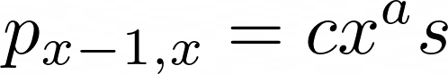
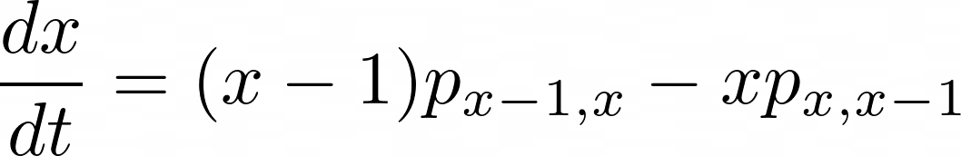
Switching Probability

Slide 5
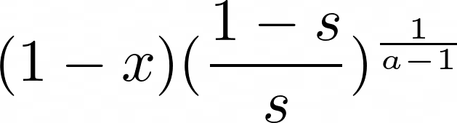
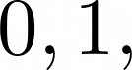
THE EQUATION
Fixed points:

Slide 6
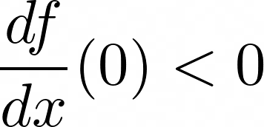
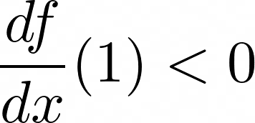
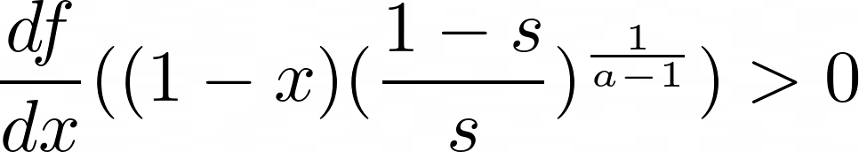
STABILITY ANALYSIS

Slide 7
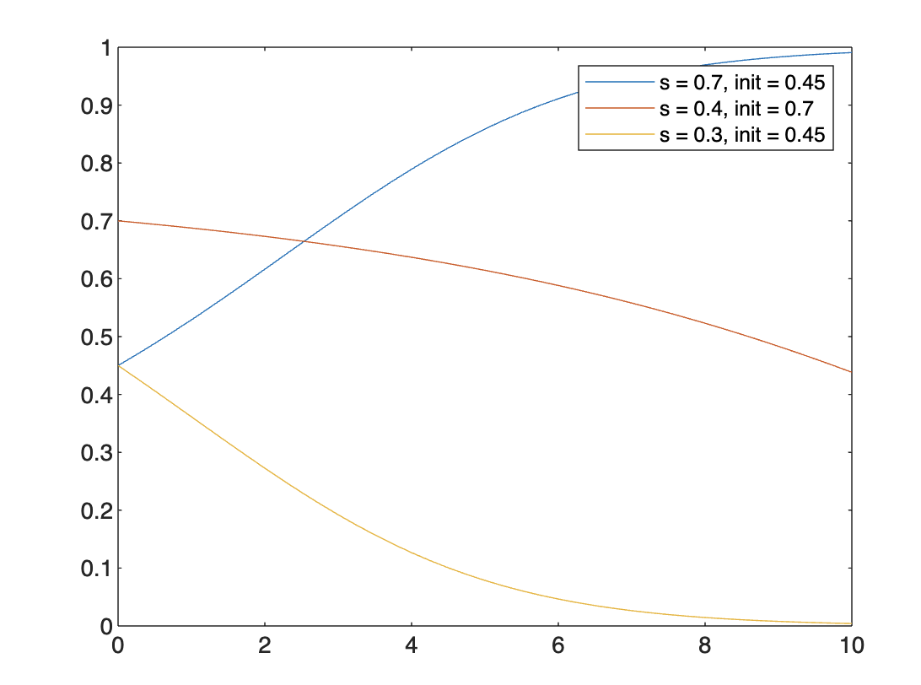
ODE SOLUTION

Slide 8
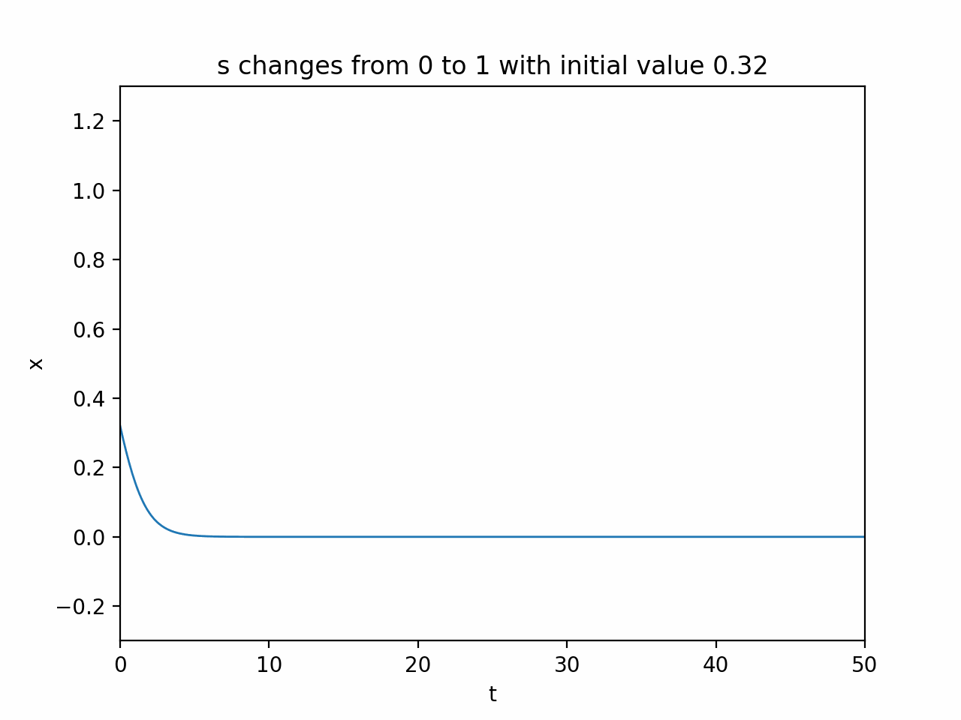
ANIMATION

Slide 9
One language always dominates over the other!!

Slide 10
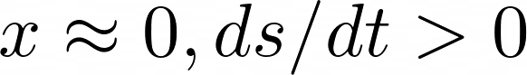
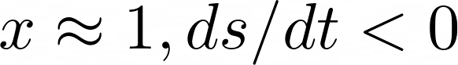
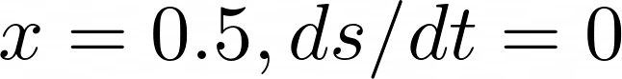
What happens if we allow the status parameter, s, to change with time?
Continuous, decreasing function!

Slide 11
FIXED POINTS
x = 0
x = 0.5
x = 1

Slide 12
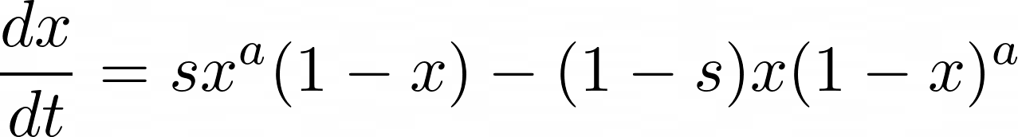
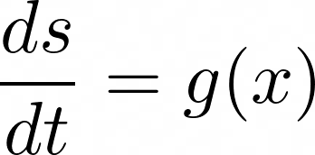
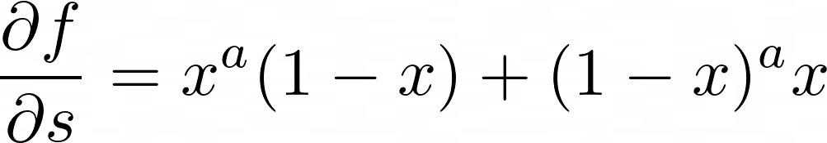
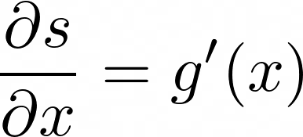
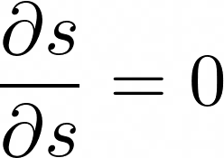
For any ds/dt chosen…

Slide 13
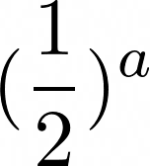
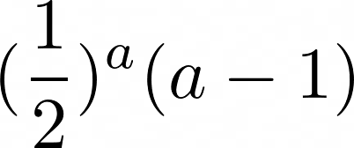
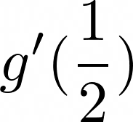

JACOBIAN AT FIXED POINT (0.5, 0.5)

Slide 14
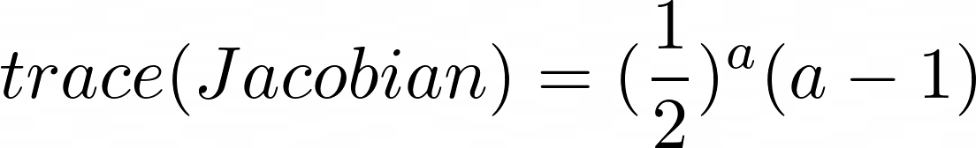
The trace is always positive, regardless of the function g(x), meaning that at least one of the eigenvalues has to have a positive component, resulting in an unstable fixed point at (0.5, 0.5)
ONE LANGUAGE ALWAYS DOMINATES!!

Slide 15
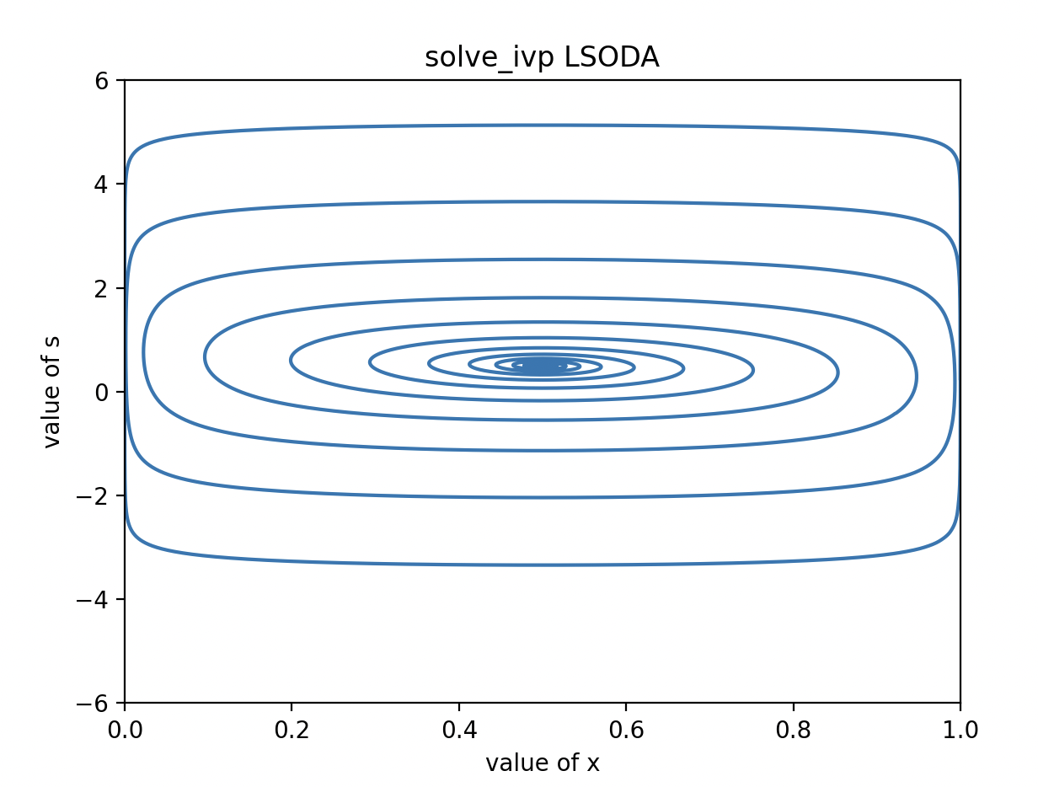
GRAPHICAL SOLUTION

Slide 16

NEW STRATEGY: LATTICE!

Slide 17
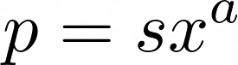
Find neighbors
Collect language
Calculate probability to switch,
Generate random number to determine switch and store the result

Slide 18
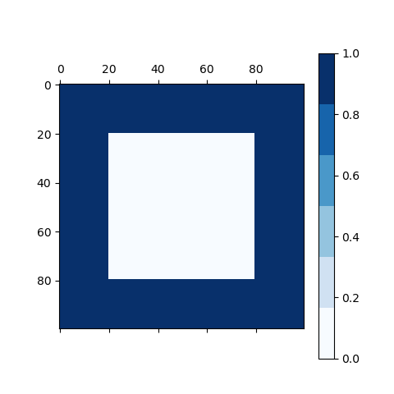
ANIMATION
Parameters:
Lang Prestige - 0.3
Pattern Number - 1
Bilingual Mode - Off

Slide 19
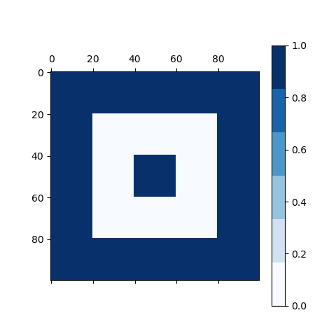
ANIMATION
Parameters:
Lang Prestige - 0.7
Pattern Number - 2
Bilingual Mode - Off

Slide 20
ANIMATION
Parameters:
Lang Prestige - 0.5
Pattern Number - 1
Bilingual Mode - Off

Slide 21
ANIMATION
Parameters:
Lang Prestige - 0.3
Pattern Number - 1
Bilingual Mode - On

Slide 22
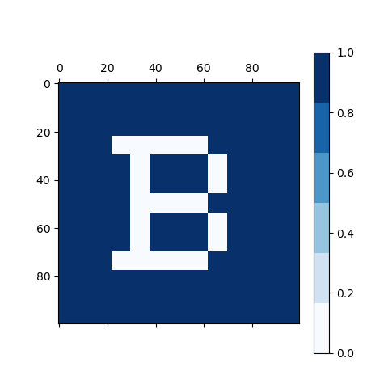
ANIMATION
Parameters:
Lang Prestige - 0.5
Pattern Number - 3
Bilingual Mode - On

Slide 23
​​References
Abrams, D. M., & Strogatz, S. H. (2003). Modelling the dynamics of language death. Nature, 424(6951), 900–900. https://doi.org/10.1038/424900a
Stauffer, D., Castelló, X., Eguíluz, V. M., & San Miguel, M. (2007). Microscopic Abrams–Strogatz model of language competition. Physica A: Statistical Mechanics and Its Applications, 374(2), 835–842. https://doi.org/10.1016/j.physa.2006.07.036

